Slide 1
Internet “of Everything”/Internet of Things
An adaptation after an (older) Cisco Networking Academy Course

Slide 2
What is IoE / IoT?
By 2025 there are an estimated 75 billion connected IoT devices globally (Statista, 2024).
IoT generates over 79.4 zettabytes of data per year by 2025 (IDC – International Data Corporation) (1 ZB = 10²¹ bytes – 1 billion terabytes)
Learning Objectives:
Identify the four pillars of IoE and how they interact
Describe the three primary interaction types: P2P, M2P, M2M
Understand how edge computing, AI, and 5G have transformed IoE
Recognize real-world IoE applications across industries

Slide 3
The Internet's Evolution — Five Phases
From Connectivity to Intelligence
Phase 1 — Connectivity (1990s): Email, web browsing, basic online access.
Phase 2 — Networked Economy (2000s): E-commerce, digital supply chains, online banking.
Phase 3 — Collaborative Experiences (2010s): Social media, mobility, cloud services.
Phase 4 — Internet of Everything (2020s): Billions of connected devices, AI-driven insights.
Phase 5 — Intelligent Automation (now): Autonomous systems, digital twins, ambient computing, AI at the edge.
Key milestone: In 2008, connected devices surpassed human population.
By 2030, the ratio is expected to exceed 10 devices per person.

Slide 4
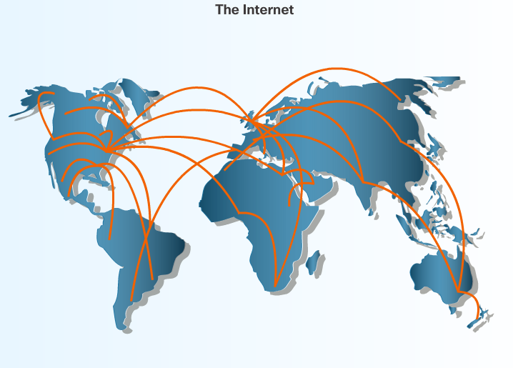
Internet – “a place to go”?
http://www.submarinecablemap.com/

Slide 5
"The Circle Story"
In a remarkably short time, the Internet transformed how we work, live, play, and learn. The next transition — from Internet to IoE — is about connecting the remaining ……?…% of things that are still unconnected.
As of 2024, only an estimated 17% of physical objects are connected. The opportunity space is enormous.
The value of IoE grows exponentially: the more connected things there are, the more valuable each new connection becomes — this is Metcalfe's Law applied to the physical world.
Reference — Cisco's original IoE vision:
https://www.cisco.com/c/en/us/solutions/internet-of-things/overview.html
World Economic Forum IoE report (2024):
https://www.weforum.org/topics/internet-of-things

Slide 6
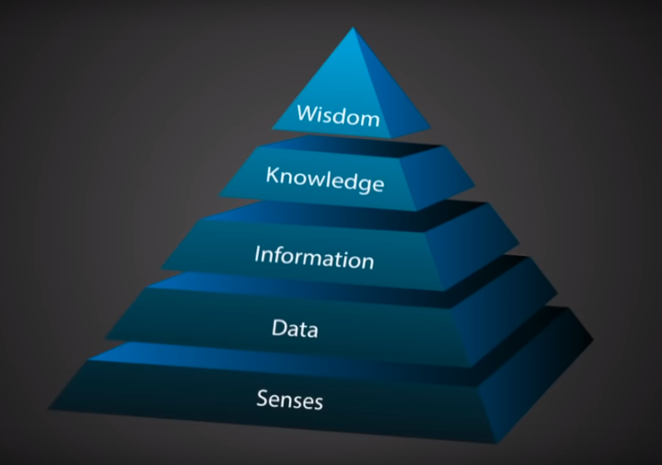
IoT is moving us forward ☺

Slide 7
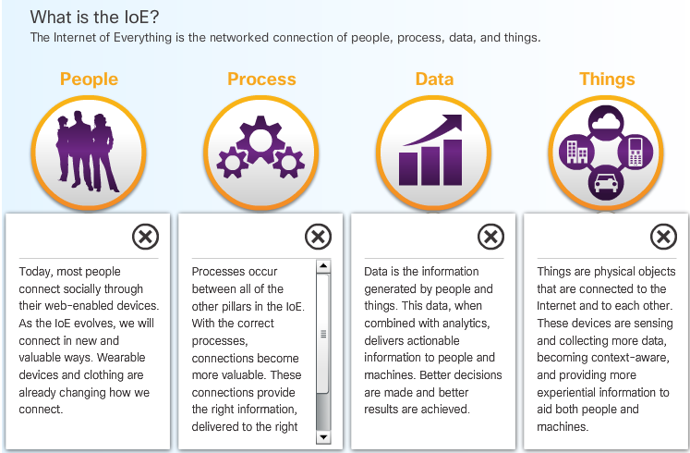
People, Process, Data, Things

Slide 8
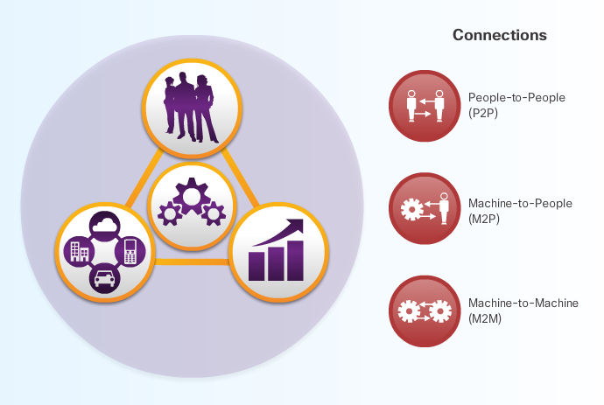
3 main connection types

Slide 9
The Need to Adapt
"The only constant is change." — Heraclitus
The pace of technological change is now measured in months, not years.
By 2025, the number of IoT devices exceeded 17 billion, and is accelerating.
Businesses that fail to embrace connected intelligence risk becoming obsolete — as happened with industries that resisted the first Internet wave.
Generative AI, edge computing, and autonomous systems are the new inflection points — just as web browsers and smartphones were in previous eras.

Slide 10
The Need to Adapt — Society & Business
People, businesses, and governments must continuously adapt to technological change.
By 2024 that ratio is 2.3 devices per person; by 2030 it could reach 10+.
Technological evolution has fundamentally changed how we share information, ideas, and opinions. People can now react to news, products, and events faster than ever — from any device, anywhere.
The ability to gather, process, and act on data in real time — using AI and edge computing — is now a competitive differentiator in every industry.
Organizations that succeed treat IoE not as a technology project but as a business transformation strategy — rethinking processes, workforce skills, and customer relationships.

Slide 11
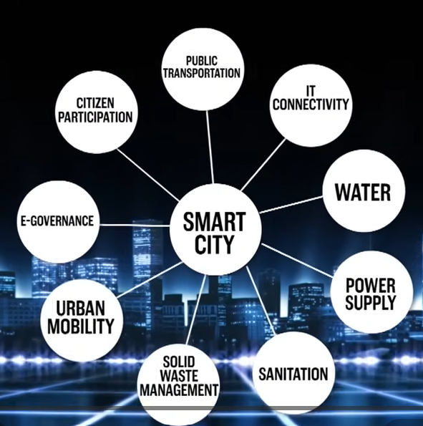
Smart cities
https://www.youtube.com/shorts/g9MJty-2Ryw

Slide 12
"Hyper-Aware", Predictive, Agile
Hyper-Aware
Real-time awareness of location, status, context of all assets, customers, and operations.
Digital twins provide live mirrors of physical systems — used in manufacturing, smart buildings, and urban planning.
Predictive
AI and machine learning analyse IoT streams to anticipate failures, demand shifts, and security threats before they occur.
Predictive maintenance alone saves industrial companies up to 25% on maintenance costs (McKinsey, 2023).
Agile
Real-time data enables faster decision cycles — from months to minutes.
Edge AI processes data locally (on-device or at the network edge), reducing latency from seconds to milliseconds.

Slide 13
IoE Applications in Manufacturing
Industry 4.0 & Smart Manufacturing
Predictive maintenance: sensors detect equipment anomalies days before failure, reducing unplanned downtime by up to 50% (Deloitte).
Digital twins: companies like Siemens and GE create virtual replicas of entire factories, running simulations before physical changes.
Autonomous robots & cobots: Amazon warehouses deploy 750,000+ robots coordinated via IoT networks (2024).
Quality control via computer vision: AI cameras inspect 100% of products at line speed, replacing sampling-based QC.
Supply chain visibility: real-time RFID and GPS tracking across global supply chains — critical lesson from COVID-19 disruptions.
Global smart manufacturing market: $395 billion by 2029 (MarketsandMarkets).

Slide 14
IoE Applications in Energy
Smart Grids, Renewables & Energy Intelligence
Smart grids: bidirectional electricity networks using IoT sensors allow real-time load balancing and fault detection.
Renewable integration: IoT enables precise forecasting of solar/wind output, helping grid operators manage intermittency.
Smart meters: over 1 billion smart electricity meters installed worldwide by end of 2023.
Vehicle-to-Grid (V2G): EV batteries used as distributed storage — IoT coordinates charge/discharge to stabilise the grid.
Building energy management: commercial buildings with IoT-based HVAC and lighting control cut energy consumption by 20–30%.
The global smart energy market is projected to reach $400 billion by 2027 (Fortune Business Insights).

Slide 15
IoE Applications in Retail
From Transactions to Intelligent Experiences
Amazon Go / Just Walk Out: computer vision + sensor fusion eliminates checkout — customers simply pick up items and leave.
Inventory management: RFID and computer vision provide real-time shelf-level inventory — reducing out-of-stocks by up to 80%.
Personalisation engines: IoT data combined with AI delivers hyper-personalised offers at the moment of purchase.
Cold chain monitoring: continuous temperature IoT sensors ensure food safety compliance from warehouse to shelf.
Smart fitting rooms: RFID-enabled mirrors suggest complementary items and check availability in real time.
Retail IoT market exceeded $94 billion in 2025 (Grand View Research).

Slide 16
5 Core Priorities for IoE Success
The IoE affects five core priorities of any organisation:
Customer Experience — Delivering hyper-personalised, context-aware interactions at every touchpoint; using real-time data to anticipate needs.
Innovation — Accelerating product development through connected feedback loops; using digital twins to prototype in virtual space before physical build.
Employee Productivity — Augmenting workers with real-time data, AI assistance, and automation — freeing humans for higher-value decisions.
Asset Utilisation — Maximising the return on physical assets through predictive maintenance, real-time tracking, and utilisation analytics.
Supply Chain Efficiency — End-to-end visibility, dynamic rerouting, and demand-driven fulfilment reducing waste and improving resilience.

Slide 17
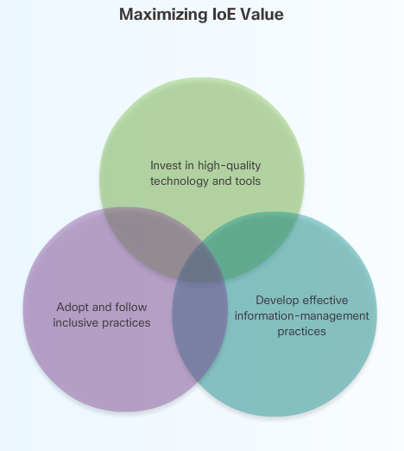
Maximizing IoE value

Slide 18
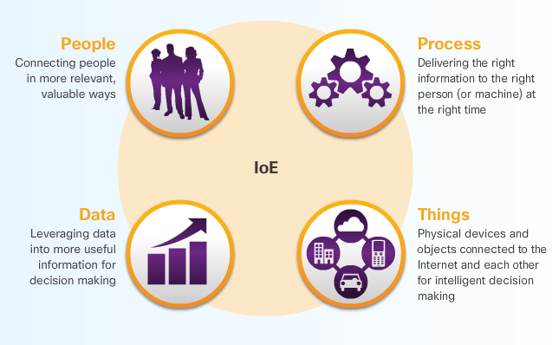
“The 4 pillars”

Slide 19
Things — The Physical Layer
What counts as a 'Thing'?
Traditional devices: computers, smartphones, tablets, servers, industrial controllers.
New categories (2020s): wearables, implantables, autonomous vehicles, drones, agricultural sensors, smart packaging, digital twins of physical objects.
Embedded intelligence: modern 'things' contain microcontrollers, AI inference chips (e.g. Google Edge TPU, Apple Neural Engine), and wireless connectivity.
Key enabling technologies:
Matter protocol — unified smart home standard backed by Apple, Google, Amazon, Samsung (last version 1.5.1, May 2026 – camera performance and device flexibility) - https://docs.aws.amazon.com/prescriptive-guidance/latest/strategy-matter-standard/understanding-matter.html
LoRaWAN / NB-IoT / LTE-M — low-power wide-area networks for battery-operated devices in remote locations.
5G mmWave — supports up to 1 million devices per km² for ultra-dense IoT deployments.
TinyML — running machine learning models on microcontrollers with <1MB RAM (Arduino, STM32, etc.).

Slide 20
Connected vs Unconnected — The Opportunity
The 'White Space' — Still Mostly Unconnected
Of the world's estimated ~200 billion physical objects, only around 17–20% are currently connected to the Internet.
The remaining 80%+ represents the growth frontier for IoE over the next decade.
Categories of connected things:
Consumer IoT: smart speakers (1.5B+), wearables (1.1B+), smart TVs, connected appliances.
Industrial IoT (IIoT): factory sensors, logistics trackers, oil & gas monitors — fastest-growing segment.
Smart city infrastructure: traffic sensors, smart streetlights, connected utilities, environmental monitors.
Healthcare IoT: remote patient monitoring, smart implants, connected diagnostics — market growing at 29% CAGR.
Total IoT connections: 17.1 billion active in 2024; forecast 39 billion by 2030 (IoT Analytics).

Slide 21
Sensors — The Nervous System of IoE
How the Physical World Becomes Data
Sensors convert physical phenomena into digital signals: temperature, pressure, motion, light, sound, chemical composition, biometrics.
Key sensor advances:
MEMS sensors (Micro-Electro-Mechanical Systems) — 1mm² chips combining accelerometer + gyroscope + barometer, used in every smartphone.
LiDAR — laser-based 3D sensing; now in autonomous vehicles (Tesla, Waymo), iPhones (since 12 Pro), and industrial robots.
Chemical/gas sensors — detecting air quality (CO₂, VOCs, particulates PM2.5) in smart buildings and wearables.
Biosensors — continuous glucose monitors (CGM), ECG patches, SpO₂ — hospital-grade readings from wrist-worn devices.
Vision sensors / cameras with AI — on-device neural processing enables real-time object detection at the edge.
Global sensor market: $302 billion by 2028 (MarketsandMarkets, 2023).

Slide 22
RFID & Beyond — Identification Technologies
From Barcodes to Intelligent Tags
RFID (Radio Frequency Identification): passive tags (no battery) readable up to 10m; 30 billion+ RFID tags shipped annually.
UHF RFID is now the standard for retail inventory (Walmart, H&M, Decathlon mandate 100% RFID tagging of apparel).
Next-generation identification:
NFC (Near Field Communication) — contactless payments, smart packaging, product authentication (Apple Pay, Google Pay, Samsung Pay).
BLE Beacons — indoor positioning with sub-3m accuracy; used in airports, hospitals, and retail for asset tracking.
Digital Product Passports (DPP) — EU regulation (2027) requiring QR/RFID tags on products containing full lifecycle data.
Printable/flexible electronics — paper-thin RFID tags that can be printed directly onto packaging — cost approaching $0.01/tag.

Slide 23
Controllers & Edge Devices
The 'Brains' at the Edge
Microcontrollers (MCUs): billions deployed in IoT — ESP32, STM32, RP2040. Run real-time OS or bare metal, draw milliwatts.
Single-Board Computers: Raspberry Pi 5 (2023) — $80 quad-core ARM Cortex-A76, 8GB RAM; full Linux for edge AI workloads.
Industrial PLCs & RTUs: legacy automation controllers now gaining Ethernet/IP and OT-IT convergence capabilities.
Edge AI accelerators:
NVIDIA Jetson Orin — 275 TOPS AI performance for robotics, autonomous machines, and smart cameras.
Google Coral Edge TPU — 4 TOPS for TensorFlow Lite inference at the sensor level.
Apple M-series Neural Engine — 38 TOPS in MacBook/iPhone; brings AI inference on-device for privacy-sensitive IoE applications.
Key trend: 'TinyML' — deploying neural networks on devices with as little as 256KB RAM and running for years on a coin battery.

Slide 24
Data Management in IoE
The Data Challenge: Volume, Velocity, Variety — and Now Value
IoT devices generate approximately 2.5 quintillion bytes of data daily (Forbes, 2024).
The critical challenge has shifted from storage to real-time processing and actionable insight extraction.
Modern data management approaches:
Edge processing: filter, aggregate, and act on data at the source — only exceptions or summaries travel to the cloud.
Stream processing: Apache Kafka, Apache Flink, and AWS Kinesis handle millions of events per second in real time.
Time-series databases: InfluxDB, TimescaleDB, QuestDB — purpose-built for IoT sensor data with nanosecond resolution.
Data lakehouse architectures: Delta Lake, Apache Iceberg — unify structured and unstructured IoT data at petabyte scale.
Data mesh: decentralised data ownership — each IoT domain (factory, fleet, building) manages its own data products.

Slide 25
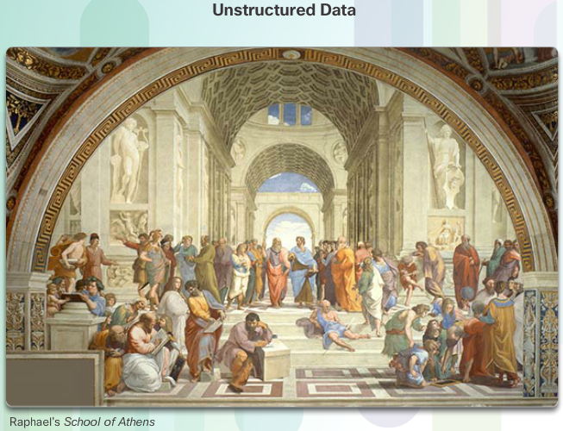
Data management

Slide 26
Data management
Currently, the things pillar, highlighted in the figure, is mostly comprised of various types of traditional computers and computing devices, such as desktops, laptops, smartphones, tablets, mainframes, and computer clusters. However, the IoT will include all types of objects, including objects and devices that are not traditionally connected. In fact, Cisco estimates that 99 percent of physical objects will one day be connected.
These objects contain embedded technology to interact with internal servers and the external environment. These objects are network-capable, and can communicate across a secure, reliable and available network platform. However, the IoT refers to a single technology transition; the ability to connect objects that were previously unconnected so those objects can communicate across the network.
The availability of data, when objects can sense and communicate, has the capability of changing how and where decisions are made, who makes the decisions, and the processes that individuals and businesses use to make those decisions. The IoE is built on the connections among people, processes, data, and things. These are the four pillars of the IoE, as shown in the figure. However, the IoE is not about these four dimensions in isolation. Each amplifies the capabilities of the other three. It is in the intersection of all of these elements that the true power of the IoE is realized.

Slide 27
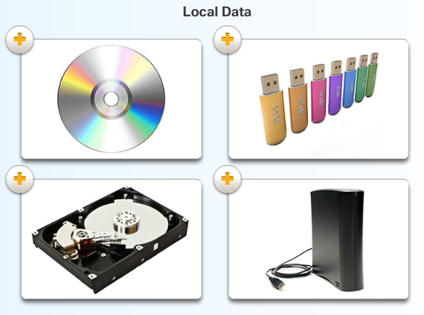
Local data
Currently, the things pillar, highlighted in the figure, is mostly comprised of various types of traditional computers and computing devices, such as desktops, laptops, smartphones, tablets, mainframes, and computer clusters. However, the IoT will include all types of objects, including objects and devices that are not traditionally connected. In fact, Cisco estimates that 99 percent of physical objects will one day be connected.
These objects contain embedded technology to interact with internal servers and the external environment. These objects are network-capable, and can communicate across a secure, reliable and available network platform. However, the IoT refers to a single technology transition; the ability to connect objects that were previously unconnected so those objects can communicate across the network.
The availability of data, when objects can sense and communicate, has the capability of changing how and where decisions are made, who makes the decisions, and the processes that individuals and businesses use to make those decisions. The IoE is built on the connections among people, processes, data, and things. These are the four pillars of the IoE, as shown in the figure. However, the IoE is not about these four dimensions in isolation. Each amplifies the capabilities of the other three. It is in the intersection of all of these elements that the true power of the IoE is realized.

Slide 28
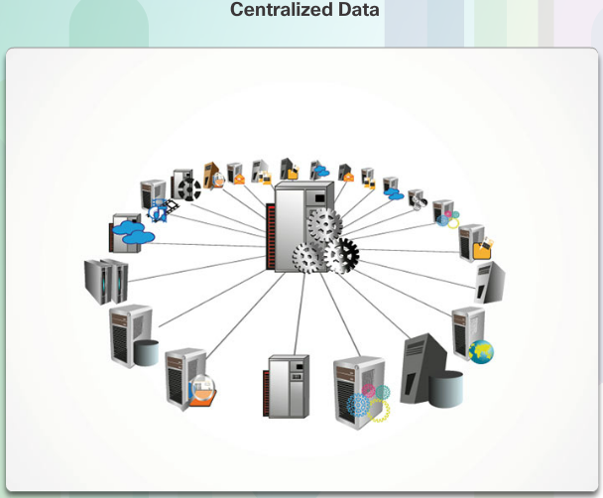
Centralized data
Currently, the things pillar, highlighted in the figure, is mostly comprised of various types of traditional computers and computing devices, such as desktops, laptops, smartphones, tablets, mainframes, and computer clusters. However, the IoT will include all types of objects, including objects and devices that are not traditionally connected. In fact, Cisco estimates that 99 percent of physical objects will one day be connected.
These objects contain embedded technology to interact with internal servers and the external environment. These objects are network-capable, and can communicate across a secure, reliable and available network platform. However, the IoT refers to a single technology transition; the ability to connect objects that were previously unconnected so those objects can communicate across the network.
The availability of data, when objects can sense and communicate, has the capability of changing how and where decisions are made, who makes the decisions, and the processes that individuals and businesses use to make those decisions. The IoE is built on the connections among people, processes, data, and things. These are the four pillars of the IoE, as shown in the figure. However, the IoE is not about these four dimensions in isolation. Each amplifies the capabilities of the other three. It is in the intersection of all of these elements that the true power of the IoE is realized.

Slide 29
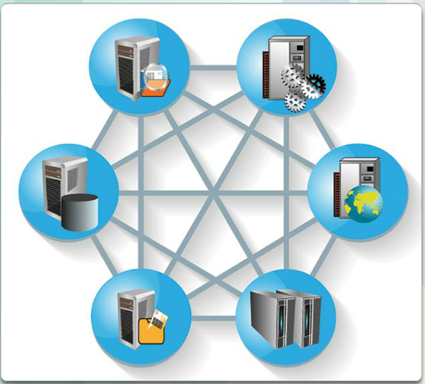
Distributed data
Currently, the things pillar, highlighted in the figure, is mostly comprised of various types of traditional computers and computing devices, such as desktops, laptops, smartphones, tablets, mainframes, and computer clusters. However, the IoT will include all types of objects, including objects and devices that are not traditionally connected. In fact, Cisco estimates that 99 percent of physical objects will one day be connected.
These objects contain embedded technology to interact with internal servers and the external environment. These objects are network-capable, and can communicate across a secure, reliable and available network platform. However, the IoT refers to a single technology transition; the ability to connect objects that were previously unconnected so those objects can communicate across the network.
The availability of data, when objects can sense and communicate, has the capability of changing how and where decisions are made, who makes the decisions, and the processes that individuals and businesses use to make those decisions. The IoE is built on the connections among people, processes, data, and things. These are the four pillars of the IoE, as shown in the figure. However, the IoE is not about these four dimensions in isolation. Each amplifies the capabilities of the other three. It is in the intersection of all of these elements that the true power of the IoE is realized.

Slide 30
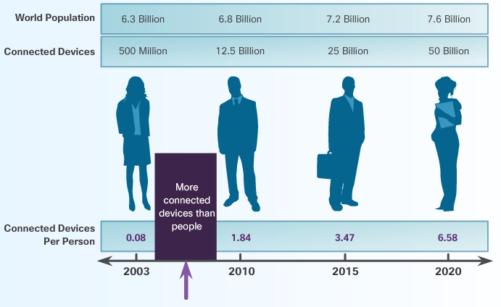
More network connections – more data
Currently, the things pillar, highlighted in the figure, is mostly comprised of various types of traditional computers and computing devices, such as desktops, laptops, smartphones, tablets, mainframes, and computer clusters. However, the IoT will include all types of objects, including objects and devices that are not traditionally connected. In fact, Cisco estimates that 99 percent of physical objects will one day be connected.
These objects contain embedded technology to interact with internal servers and the external environment. These objects are network-capable, and can communicate across a secure, reliable and available network platform. However, the IoT refers to a single technology transition; the ability to connect objects that were previously unconnected so those objects can communicate across the network.
The availability of data, when objects can sense and communicate, has the capability of changing how and where decisions are made, who makes the decisions, and the processes that individuals and businesses use to make those decisions. The IoE is built on the connections among people, processes, data, and things. These are the four pillars of the IoE, as shown in the figure. However, the IoE is not about these four dimensions in isolation. Each amplifies the capabilities of the other three. It is in the intersection of all of these elements that the true power of the IoE is realized.

Slide 31
"Big Data" — The 6 Vs of IoE Data
Beyond the Original 3 Vs — IoE adds three more:
Volume — IoT generates 73.1 zettabytes of data per year by 2025; hyperscalers process petabytes daily.
Velocity — data arrives in real-time streams (microsecond to millisecond); batch processing is no longer sufficient.
Variety — structured sensor readings, unstructured video/audio, semi-structured JSON/MQTT messages.
Veracity — data quality: faulty sensors, network dropouts, and calibration drift require robust data validation pipelines.
Value — raw data has limited worth; value comes from AI-driven analysis, cross-source correlation, and actionable alerts.
Vulnerability — IoT data is personal, operational, and critical infrastructure data — security and privacy are not optional.
Infrastructure requirement: edge-to-cloud continuum — process where it makes economic and latency sense, not just in the cloud.

Slide 32
Big Data Analytics & AI in IoE
From Data to Decisions — Faster Than Ever
Descriptive analytics: dashboards and visualisations showing current state — asset tracking, environmental monitoring.
Diagnostic analytics: root cause analysis of failures and anomalies using historical IoT logs.
Predictive analytics: ML models forecasting equipment failure, energy demand, patient deterioration hours to days in advance.
Prescriptive analytics: AI recommends (or autonomously takes) the optimal action — route re-planning, dosage adjustment, grid rebalancing.
Key advances in the last years:
LLM-powered IoT interfaces: natural language queries over sensor data — 'Why did Line 3 slow down at 2am?'
Federated learning: train ML models across distributed IoT devices without centralising raw data — preserving privacy.
Foundation models for time series: TimeGPT, Chronos — general-purpose forecasting models pre-trained on billions of IoT readings.

Slide 33
Virtualisation & Containerisation in IoE
From Hardware Silos to Software-Defined Infrastructure
Server virtualisation (VMware, Hyper-V, KVM) remains foundational — but is increasingly being complemented by containers.
Containers (Docker, containerd): package IoT applications with their dependencies — deploy identically from cloud to edge gateway.
Kubernetes: orchestrates containerised IoT workloads across thousands of edge nodes — auto-scales with device count.
KubeEdge / K3s: lightweight Kubernetes distributions designed for resource-constrained edge devices (Raspberry Pi and above).
Virtual Representations:
Digital Twins: real-time virtual replicas of physical assets. Azure Digital Twins, AWS IoT TwinMaker, NVIDIA Omniverse.
Network Function Virtualisation (NFV): IoT gateways and network functions run as software, not dedicated hardware — reduces cost and increases flexibility.

Slide 34
Cloud Computing — The IoE Backbone
Multi-Cloud & Hybrid Architectures for IoE
AWS IoT Core: connects billions of devices; supports MQTT, HTTPS, WebSockets; deep integration with Lambda, S3, SageMaker.
Azure IoT Hub / IoT Central: enterprise-grade device management, OTA updates, and certified device catalogue.
Google Cloud IoT: integration with BigQuery and Vertex AI for analytics; strong in retail and smart building verticals.
The Edge-to-Cloud Continuum:
Not all data should go to the cloud. The modern IoE architecture uses a tiered model:
Device edge: TinyML inference on MCU (microseconds latency)
Network edge / fog: gateways aggregate and filter (milliseconds)
Regional cloud: deeper analytics, model training, long-term storage (seconds)
Global cloud: business intelligence, cross-regional correlation (seconds–minutes)

Slide 35
IoE Cloud Platforms — A Comparison
Leading Platforms
AWS IoT: broadest service portfolio; IoT Core + Greengrass (edge) + SiteWise (industrial) + TwinMaker; 200+ services.
Microsoft Azure IoT: strongest enterprise/OT integration; Azure IoT Operations (2024) unifies cloud and edge management.
Google Cloud IoT: best-in-class AI/ML integration via Vertex AI; strong in retail analytics and smart cities.
Siemens MindSphere: industrial IoT platform; deep integration with Siemens OT equipment and digital twin tools.
PTC ThingWorx: industrial IoT + AR; widely used in manufacturing for real-time operational intelligence.
Open standards gaining momentum:
OPC UA: unified industrial communications standard — now with MQTT transport profile for cloud connectivity.
Eclipse Sparkplug: defines MQTT topic namespace and payload structure for IIoT.
OpenTelemetry: vendor-neutral observability framework increasingly adopted for IoT device telemetry.

Slide 36
IoE Security — The Critical Priority
Security can no longer be an afterthought
The IoT threat landscape: 1.5 billion IoT attacks recorded in H1 2023 alone (Kaspersky). Cameras, routers, and industrial PLCs are top targets.
High-profile incidents: Stuxnet (industrial), Mirai botnet (consumer IoT DDoS), water treatment plant attacks (SCADA/OT).
Security-by-Design Principles:
Unique device identities: hardware root of trust (TPM, Secure Element) — every device cryptographically authenticated.
Zero Trust for IoT: no device is trusted by default — micro-segmentation, least-privilege access, continuous verification.
OTA (Over-the-Air) updates: automated patching pipeline — unpatched IoT devices are the #1 attack vector.
SBOM (Software Bill of Materials): knowing every software component in a device — required by US executive order (2021) and EU Cyber Resilience Act (2024).
IoT security market: $59 billion by 2028 (MarketsandMarkets).

